Slide 1
Convolutional Neural Networks

Slide 2
Hello!
I am Frederick Apina
Machine Learning Engineer @ParrotAI I am here because I love to give presentations.

Slide 3
“When I think about strong innovations in term of automation, cognitive computing, and artificial intelligence, they will be coming a lot from Tanzania as well.”

Slide 4
1.
What are Convolutional Neural Networks?

Slide 5
CNN
Convolutional Neural Networks (ConvNets or CNNs) are a category of Neural Networks that have proven very effective in areas such as image recognition and classification. ConvNets have been successful in identifying faces, objects and traffic signs apart from powering vision in robots and self driving cars.

Slide 6
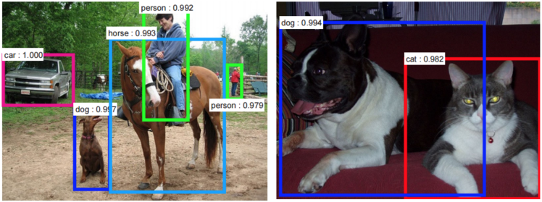

Slide 7
There are four main operations in the ConvNet
Convolution
Non Linearity (ReLU)
Pooling or Sub Sampling
Classification (Fully Connected Layer)

Slide 8
An Image is a matrix of pixel values

Slide 9
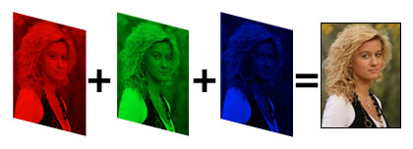
Channel is a conventional term used to refer to a certain component of an image. An image from a standard digital camera will have three channels – red, green and blue – you can imagine those as three 2d-matrices stacked over each other (one for each color), each having pixel values in the range 0 to 255

Slide 10
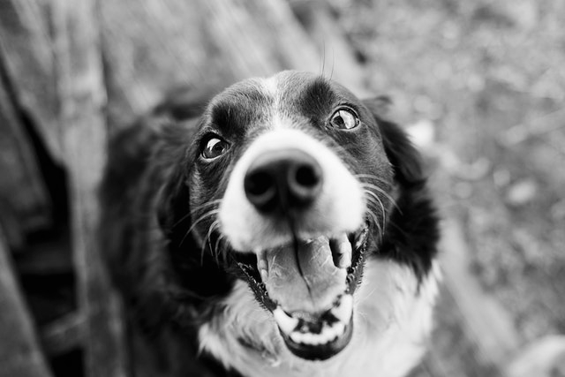
A grayscale image, on the other hand, has just one channel. For the purpose of this post, we will only consider grayscale images, so we will have a single 2d matrix representing an image. The value of each pixel in the matrix will range from 0 to 255 – zero indicating black and 255 indicating white.

Slide 11
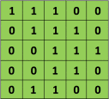

The Convolution Step
ConvNets derive their name from the “convolution” operator. The primary purpose of Convolution in case of a ConvNet is to extract features from the input image. Convolution preserves the spatial relationship between pixels by learning image features using small squares of input data.
3x3 matrix
5x5 matrix

Slide 12
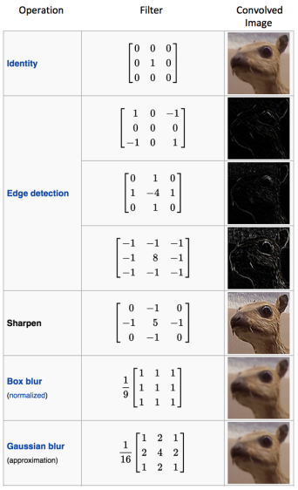

In CNN terminology, the 3×3 matrix is called a ‘filter‘ or ‘kernel’ or ‘feature detector’ and the matrix formed by sliding the filter over the image and computing the dot product is called the ‘Convolved Feature’ or ‘Activation Map’ or the ‘Feature Map‘.
Take this image

Slide 13
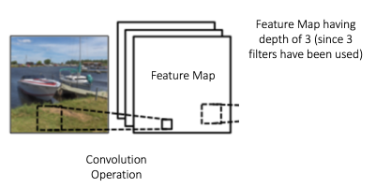
In practice, a CNN learns the values of these filters on its own during the training process (although we still need to specify parameters such as number of filters, filter size, architecture of the network etc. before the training process). The more number of filters we have, the more image features get extracted and the better our network becomes at recognizing patterns in unseen image
The size of the Feature Map (Convolved Feature) is controlled by three parameters that we need to decide before the convolution step is performed:
1. Depth
2. Stride
3. Zero-padding

Slide 14
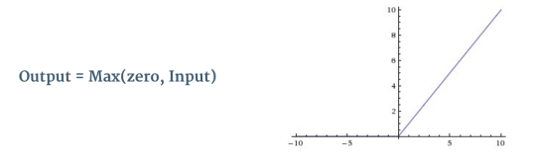
Introduction to Non-Linearlity
ReLU stands for Rectified Linear Unit and is a non-linear operation. Its output is given by:

Slide 15
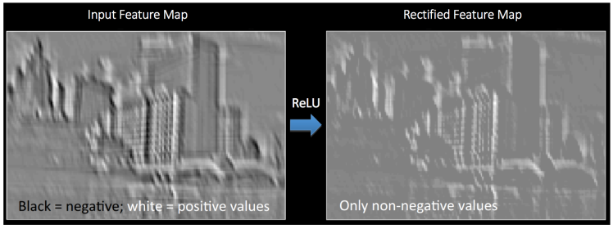
ReLU is an element wise operation (applied per pixel) and replaces all negative pixel values in the feature map by zero. The purpose of ReLU is to introduce non-linearity in our ConvNet, since most of the real-world data we would want our ConvNet to learn would be non-linear.

Slide 16
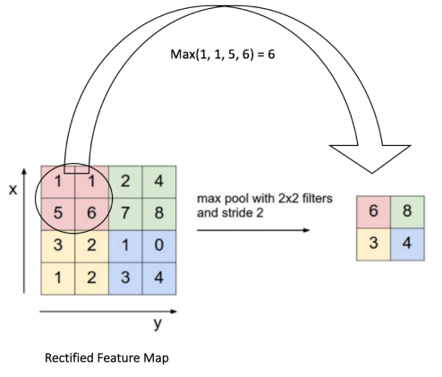
The Pooling step
Spatial Pooling (also called subsampling or downsampling) reduces the dimensionality of each feature map but retains the most important information. Spatial Pooling can be of different types: Max, Average, Sum etc.

Slide 17
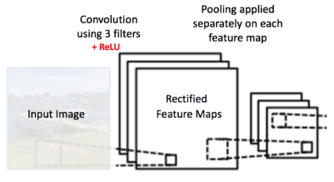

Slide 18
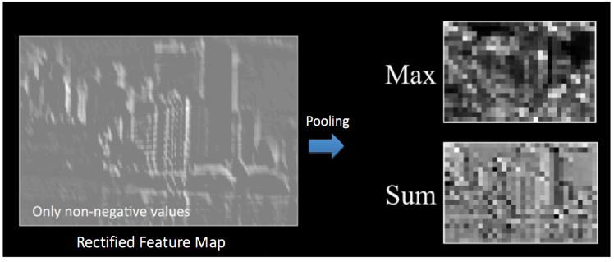

Slide 19
The function of Pooling is to progressively reduce the spatial size of the input representation. In particular, pooling;
makes the input representations (feature dimension) smaller and more manageable
reduces the number of parameters and computations in the network, therefore, controlling overfitting.
makes the network invariant to small transformations, distortions and translations in the input image (a small distortion in input will not change the output of Pooling – since we take the maximum / average value in a local neighborhood).

Slide 20
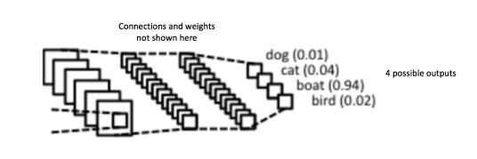
Full Connected Layer
The term “Fully Connected” implies that every neuron in the previous layer is connected to every neuron on the next layer.
The output from the convolutional and pooling layers represent high-level features of the input image. The purpose of the Fully Connected layer is to use these features for classifying the input image into various classes based on the training dataset.

Slide 21
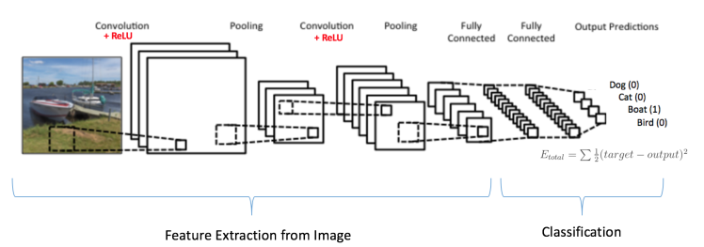
Putting it all together – Training using Backpropagation
The Convolution + Pooling layers act as Feature Extractors from the input image while Fully Connected layer acts as a classifier.
The output from the convolutional and pooling layers represent high-level features of the input image. The purpose of the Fully Connected layer is to use these features for classifying the input image into various classes based on the training dataset.

Slide 22
The overall training process of the Convolution Network may be summarized as below:
Step1: We initialize all filters and parameters / weights with random values
Step2: The network takes a training image as input, goes through the forward propagation step (convolution, ReLU and pooling operations along with forward propagation in the Fully Connected layer) and finds the output probabilities for each class.
Step3: Calculate the total error at the output layer (summation over all 4 classes)
Total Error = ∑ ½ (target probability – output probability) ²
Step4: Use Backpropagation to calculate the gradients of the error with respect to all weights in the network and use gradient descent to update all filter values / weights and parameter values to minimize the output error.
Step5: Repeat steps 2-4 with all images in the training set.

Slide 23
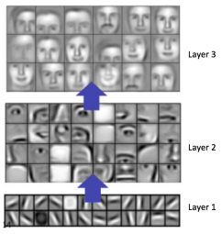
Visualizing Convolutional Neural Networks

Slide 24
Conclusion
Deep Learning is an continuously-growing and a relatively new concept, the vast amount of resources can be a touch overwhelming for those either looking to get into the field, or those already engraved in it. A good way of cooping is to get a good general knowledge of machine learning and then find a good structured path to follow (be a project or research).

Slide 25
Thanks!
Any questions?
You can find me at:
Fred.apina@gmail.com

